Slide 1
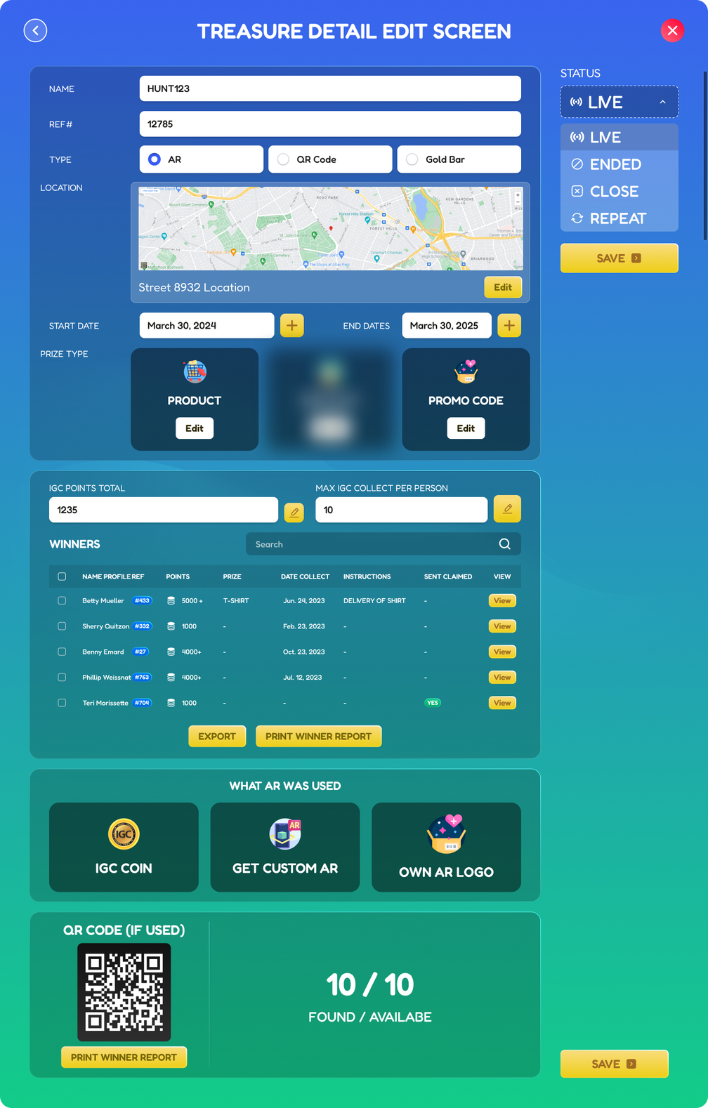
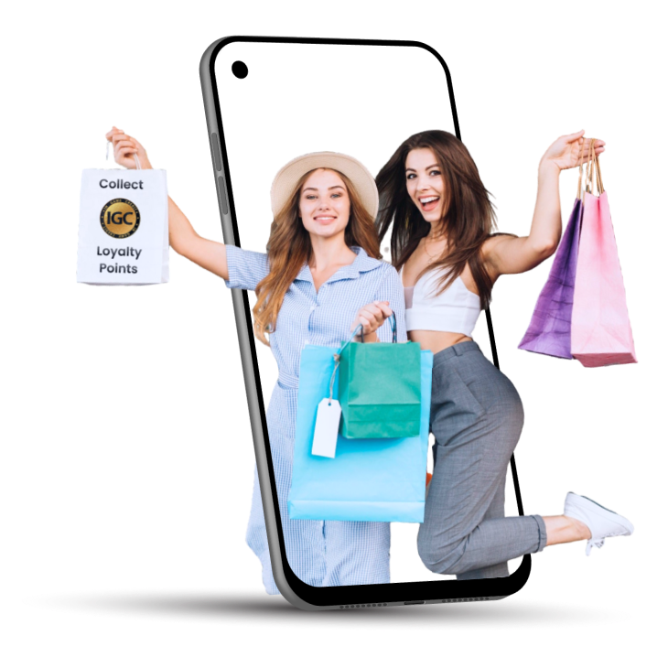
Brand Proposal / Media Kit
Loyalty Points and Pop up Stores
Virtual Reality Experience Stores
10 Exclusive Brands
Powered by a Coordinated Social Media Campaign
MegaMalls Powered by InGameCredit (IGC)
MegaMall.tech / InGameCredit.com

Slide 2

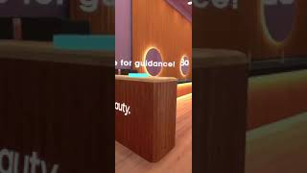
#MegaMall Powered by IGC
1
10 exclusive partner brands, we are launching a coordinated, multi-brand mega mall campaign
Each brand features its own exclusive, location-based Pop up story that delivers a unique, audience-driven brand story.
With exclusive, hard-to-get drops from top brands, mega prizes, and strategically coordinated clues, we’re crafting an unforgettable customer experience.
2
3
We’re specifically targeting a young teen demographic—fans of artists like Taylor Swift and Sabrina Carpenter—by partnering with desirable brands in food, fashion, and beauty that resonate with their interests. It’s a coordinated marketing effort designed to align perfectly with their lifestyle and preferences
Ongoing clue drop events are in place for fashion, auto, fitness, groceries and sport as our system is built for global ongoing.
Example pop up store: Our platform is the one stop shop for the APP build, hunt, clues, store tech, data, fulfilment and redemption for the campaign

Slide 3
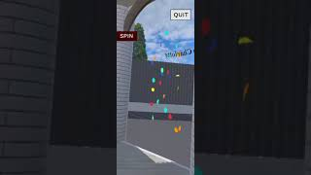




Create an immersive brand experience through an interactive Virtual Reality pop-up store — with clue-based locations revealed on social media. #MegaMall
Q: Do brands get their own app? Is it standalone, part of their existing app, or within the MegaMall app? A: We offer all options—standalone, integrated into the brand’s existing app, or within the MegaMall app—depending on budget and timeline. Integrating with an existing app may take longer due to coordination with the brand’s current team and framework.
Q: How much space is needed, and what kind of location?A: We’ve tested in publicly accessible areas and can suggest ideal spots. The space depends on your store layout, as the experience is life-sized—users walk through it just like a real store.
Q: What happens if it rains or it’s nighttime? A: Our tests show users stay engaged rain or shine. Plus, our system lets you control when and how promotions are released.
Q: Can we reuse the software? or make changes later A: Yes, it’s built for ongoing or seasonal use. For example, MegaMall will run again in December and January School holidays, or whenever brands desire.
Q: What changes can we make for our pop-up store? A: The canvas is set—you have full creative freedom to design your own unique brand experience.

Slide 4

Virtual interactive stores built located through clues
MEGA MALL DROP 2025 – Brand Participation Proposal
Confidential: Subject to NDA
Overview
Mega Mall Drop – a first-of-its-kind, immersive campaign event designed to captivate a powerful, trend-savvy demographic: teens and young adults deeply engaged with social media, cosmetics, and icons like Taylor Swift and Sabrina Carpenter. Our virtual reality individual pop up stores focus on desirable beauty, jewelry, food, frozen yoghurt, fashion and experiences for the targeted demographic.
Exclusive under NDA brands, we have curated a roster of premium lifestyle and cosmetics brands, this event aims to deliver a thrilling treasure hunt-style experience culminating in an exclusive, high-impact virtual retail activation.
What we have organised
We have already organised exclusive teen focussed drops, authentic signed memorabilia. Signed Sabrina, Taylor Swift, Olivia Rodrigo Merchandise, Demographic specific fast food vouchers, exclusive deals. Four pop up stores are ready for the campaign. Our purpose is to achieve a mall environment of drops specifically tailored to this demographic.
What we want
Brands that align with the demographics. Innovative and willing work with our cutting edge technology. Brands that can offer desirable drops that are sought after for the campaign.

Slide 5
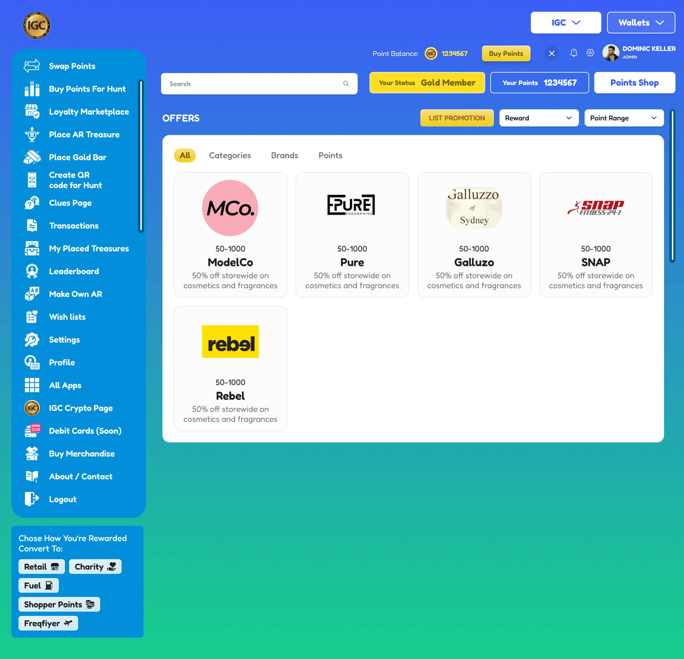
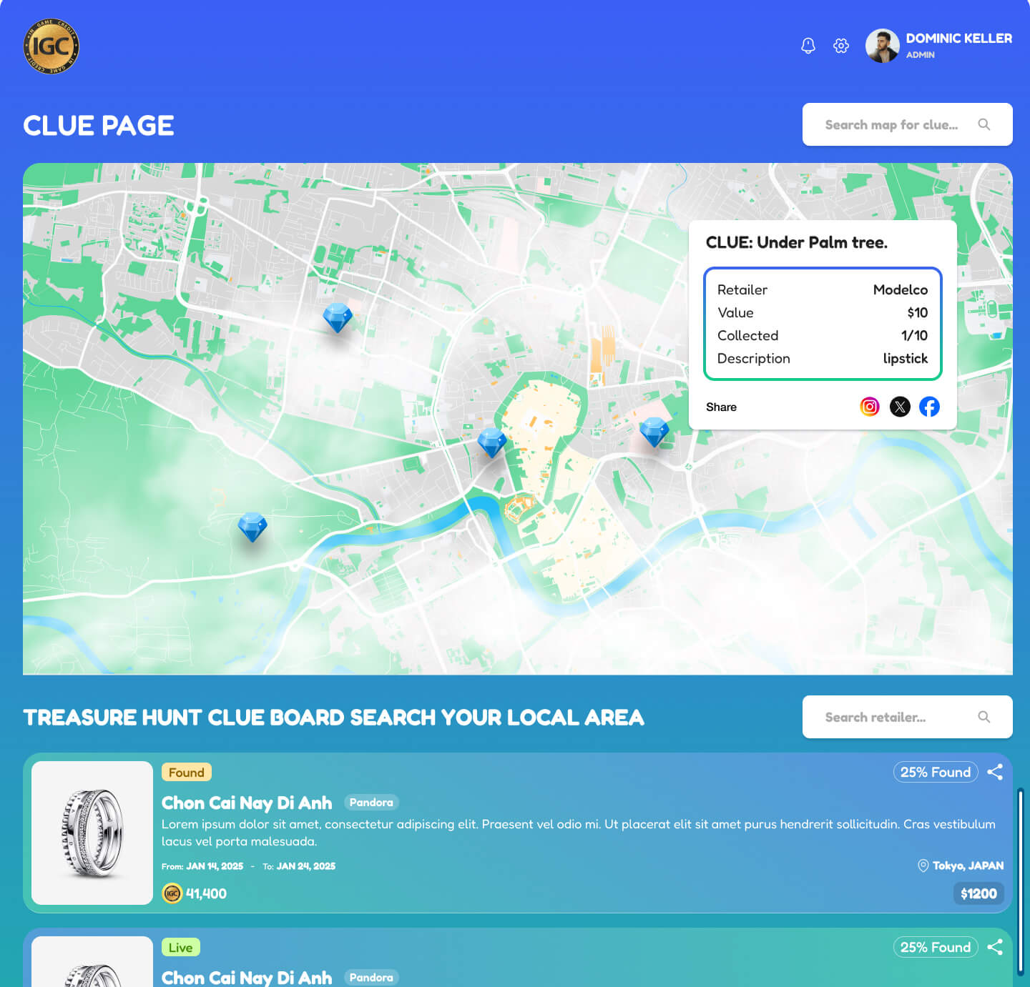
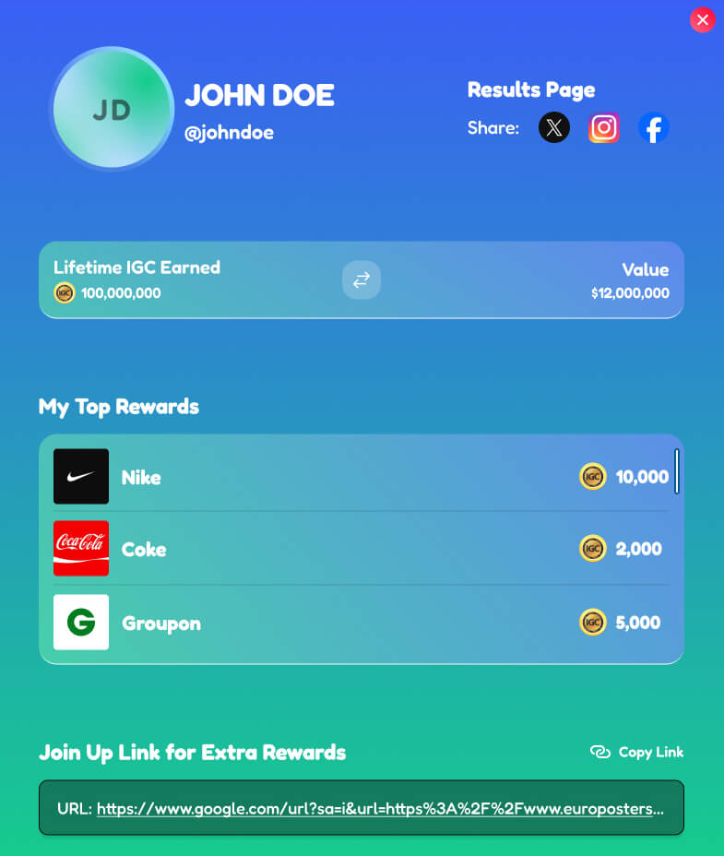
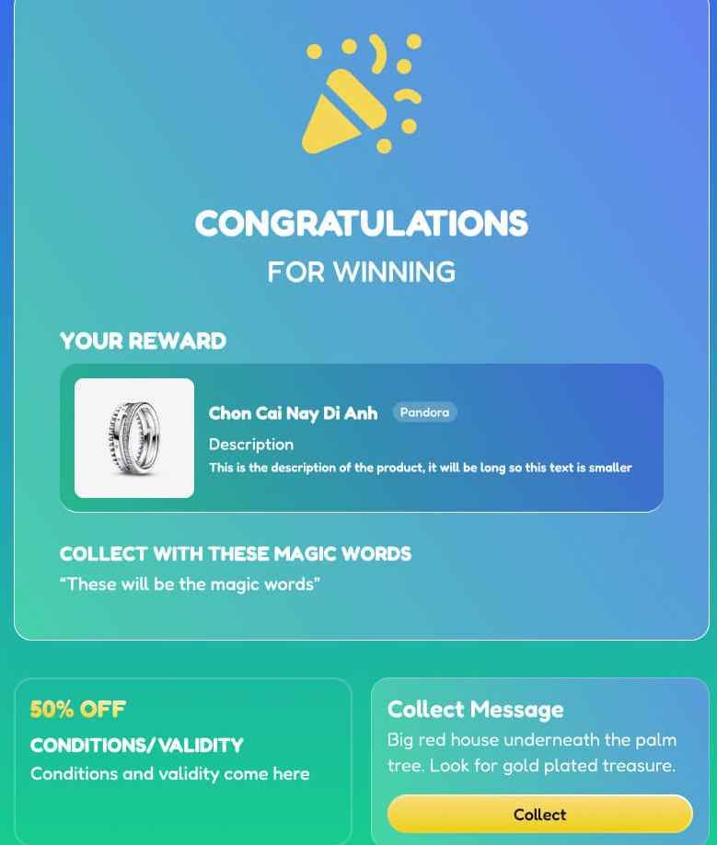
Services include
APP / Pop Up Store & Marketplace
Clue section and Map
Own URL promotion
QR code, Promo and Product fulfillment integration

Slide 6
MegaMall Pop Up Stores
Step 1: Discovery & Engagement
A potential customer learns that your brand is hosting an exclusive, immersive treasure hunt pop-up store in virtual reality. They visit a specially designed landing page featuring clues, maps, and app download information.
Step 2: Excitement & Anticipation
Excited by the concept, the customer shares the event with friends and follows the provided clues and map details. Upon arrival at the designated location, they view an incredible, futuristic, life-sized pop-up store through their phone’s augmented reality interface.
Step 3: Immersive Brand Experience
Your AR-powered store is fully branded, ultra-modern, and interactive. Customers can engage with animated elements such as confetti bursts, dynamic lighting, and unlockable surprises.
Step 4: Personalization & Interaction
A holographic brand ambassador (which could be an influencer or a celebrity) greets the customer. The store offers a 360-degree interactive experience, showcasing high-resolution product displays. Integrated seamlessly, the platform enables easy purchasing and promotional redemption.
Step 5: Gamification & Engagement
Customers engage with fun elements such as scratch-and-win promotions, mystery boxes, and spinning wheels to unlock exclusive deals. The experience is not only visually stunning but also rewarding and interactive.
Step 6: Call to Action & Retention
As the customer exits the virtual experience, they encounter additional incentives, such as balloons, discount vouchers, or free promotional items. Post-experience, our platform manages transactional details and ensures seamless fulfillment.

Slide 7
MegaMall Pop Up Stores
What is the Mega Mall Drop?
The Mega Mall Drop is a real-world discovery campaign powered by digital mystery and brand storytelling.
A heavily promoted “mystery” event across TikTok, Instagram, YouTube, and influencer channels.
Brands collaborate by leaking location clues via their own channels and audiences.
Our system manages the clue distribution and tracking, ensuring coordinated, exciting progression.
Each brand has its own unique pop up store with curated experience. Built in collaboration with our tech team. Prices are fixed for small, medium and enterprise which includes their own APP + ours, data, and we build all the tech for you.
When users decode the clues and arrive at the secret Mega Mall location, they will enter a dynamic Virtual Reality Pop-Up Mall via our app – featuring a customized storefront experience for each participating brand.
Why are multiple brands included? To maximise the campaign for all. We limit the category for each brands exclusivity depending on the level of engagement and wishes.

Slide 8
MegaMall Pop Up Stores
Why Participate?
Mass exposure through viral marketing campaigns across multiple brand and influencer channels.
Innovative positioning – be seen as a cutting-edge brand shaping new kinds of digital retail.
Sales & engagement uplift – through exclusive offers and real-time participation.
Data insights – understand behaviors and preferences of your future customers.
What We Need From You
A signed Non-Disclosure Agreement (NDA) to maintain campaign confidentiality.
Next step to:
  Discussion call to ensure the right fit
  Demonstration

Slide 9
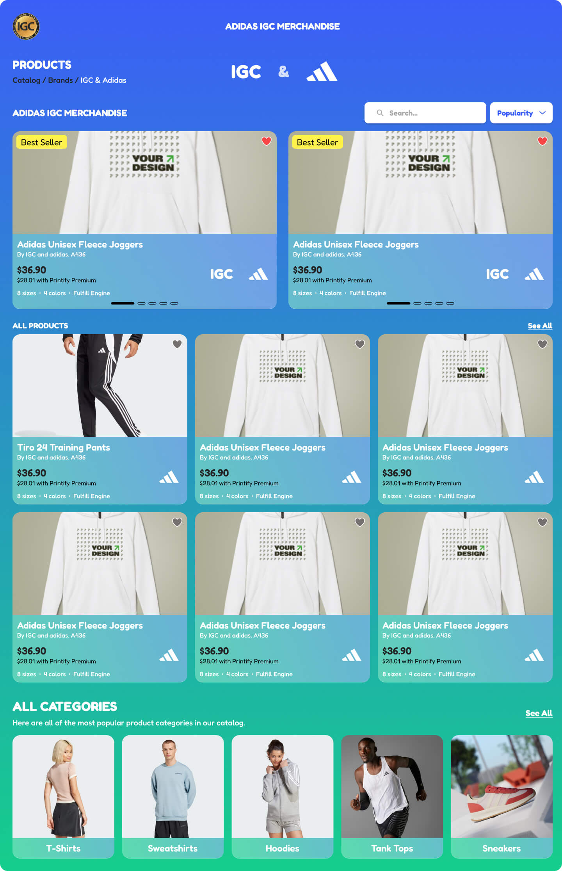
Immersive Pop Up Stores
Next Generation Marketing
We create extraordinary pop-up stores that drive real foot traffic to your targeted locations. Our platform integrates seamlessly with:
Social media engagement: Leverage interactive clues and map-based adventures.
Location-based marketing: Guide customers to key locations.
Interactive product drops: Offer exclusive items in augmented reality.
Loyalty program integration: Reward customers with redeemable points.
Data-driven insights: Capture valuable user behavior analytics.
Each brand pop-up store tells a unique story, tailored to your brand’s vision. Examples include:
Custom holographic concierges
Full 360-degree interactive rooms
Mystery promotions & exclusive deals
Call-to-action prompts for deeper engagement
Our purpose-built technology offers turnkey
and customizable solutions for:
Design & product integration
Shipping & logistics integration
Loyalty points distribution
Marketplace sales expansion
Social media and advertising synchronization

Slide 10

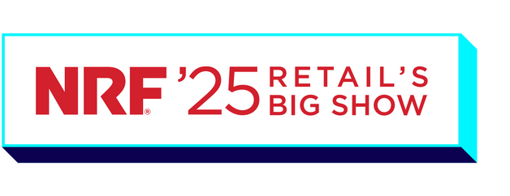
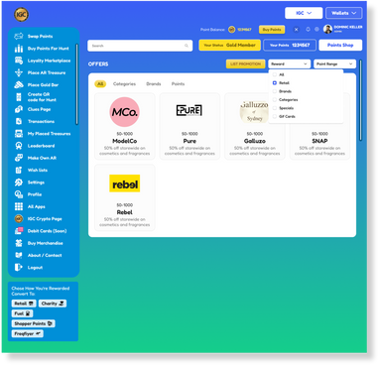
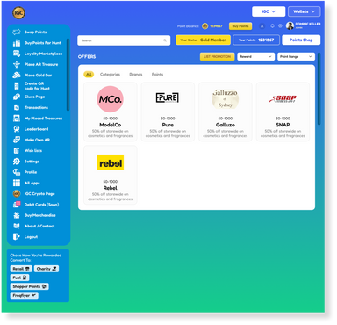

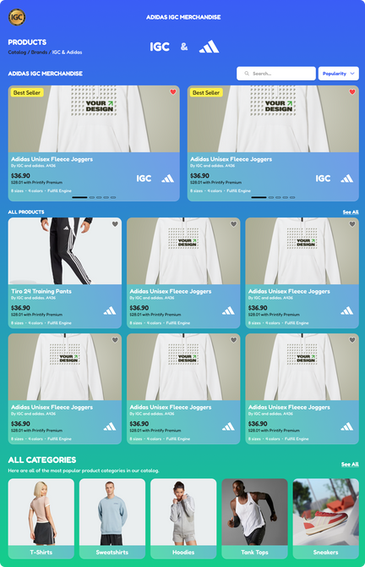
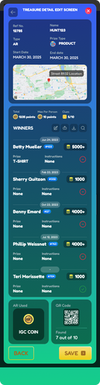

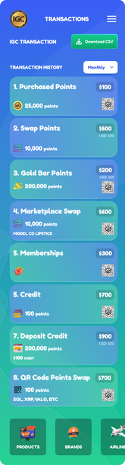
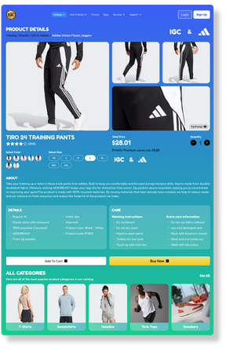
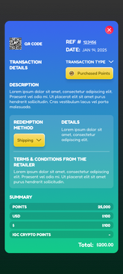


INGAMECREDIT.COM
AWARDS / ACKNOWLEDGEMENTS
IGC was awarded a RippleX grant to enhance the platform's blockchain capabilities. Ripple,
is a leading provider of digital asset infrastructure for financial services, enables real-time
cross-border payments and supports tokenization and digital asset innovation.
IGC was selected by the National Retail Federation (NRF) for the Innovation Zone at the
world's largest retail trade show in New York, recognizing it as a top company
driving innovation and transformation in
the retail industry.

Slide 11






SOCIAL MEDIA
PROFILES
MegaMall.tech / InGameCredit.com
x.com/RealMegaMall
instagram.com/RealMegaMall
tiktok.com/@RealMegaMall
youtube.com/kmSqfCWQSiY
#MegaMall Campaign
CONTACT INFORMATION
Press & Media Inquiries: simon@ingamecredit.com
Partnership Opportunities: simon@ingamecredit.com
Customer Support:
info@ingamecredit.com
ADDITIONAL RESOURCES
FAQs about IGC:
ingamecredit.com/igc-help-center/

